Slide 1
UI
Daniel Janák

Slide 2
Content of this lecture
Core content
UMG & Designer
Widget Templating
Focus
Views
Layers
UI Management
Additional Resources
Optional Content
Generic Layouting
Animations
UI Materials

Slide 3
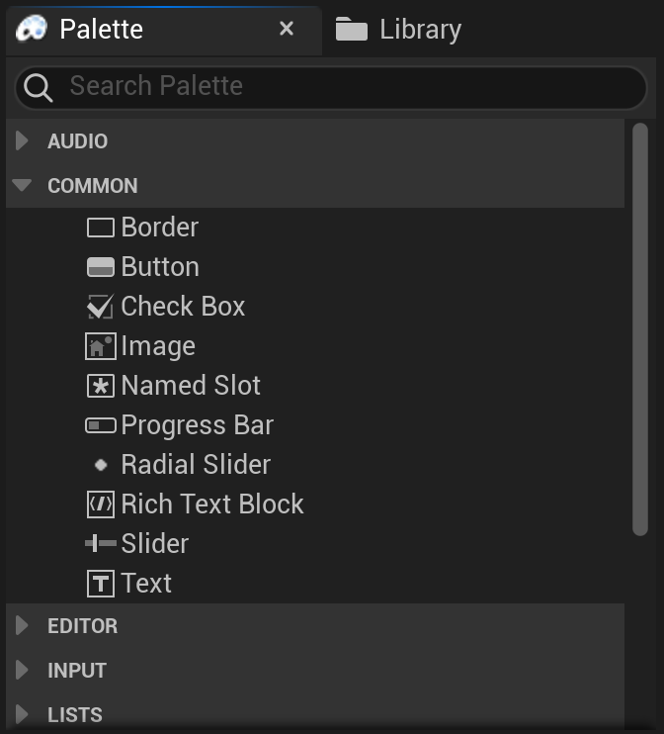
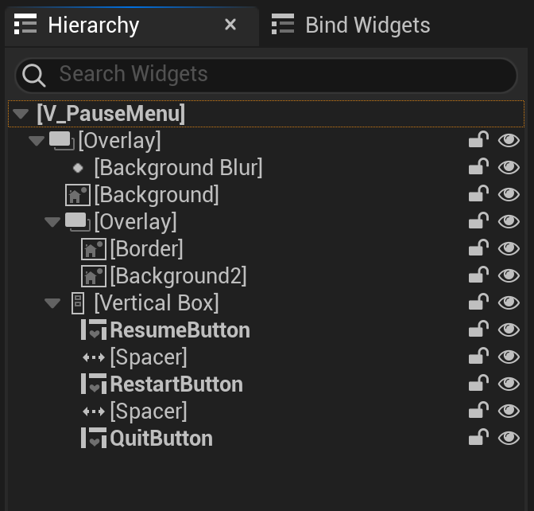
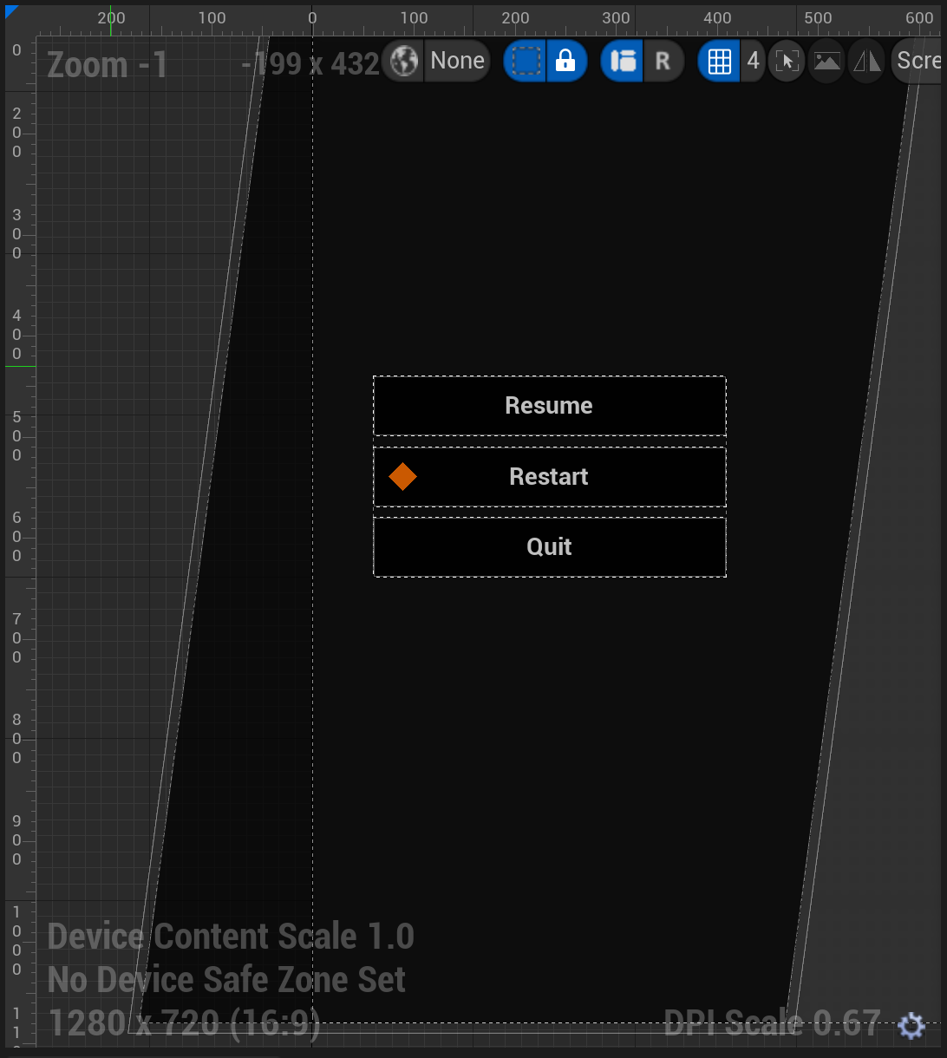
UMG & Designer
Unreal Motion Graphics - Default UI system
Widget vs User Widget

Slide 4
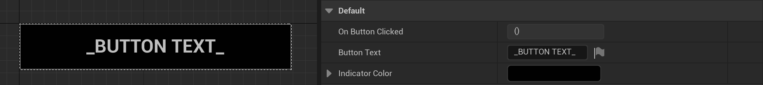
Widget Templating
Unreal Tutorial
Reusable Visual for Widgets
Additional Properties
Forwarding Events

Slide 5
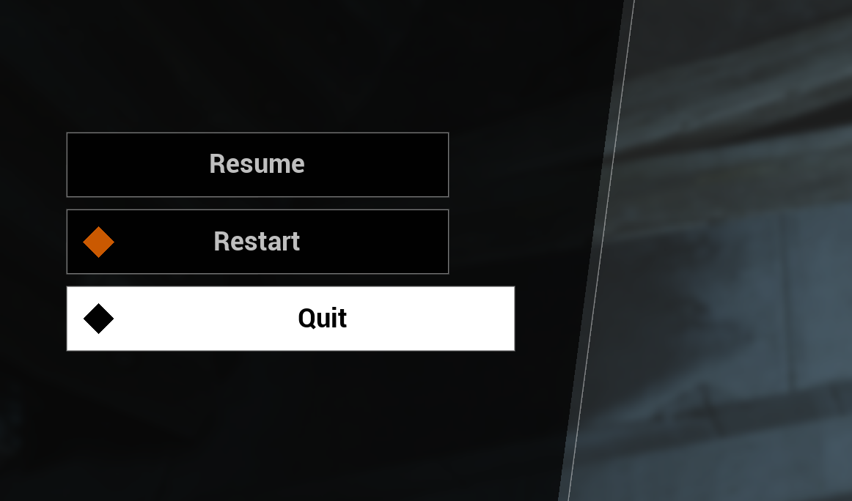
Focus
Core mechanism behind UI navigation
Only one focused widget at a time
Focus vs Hover

Slide 6
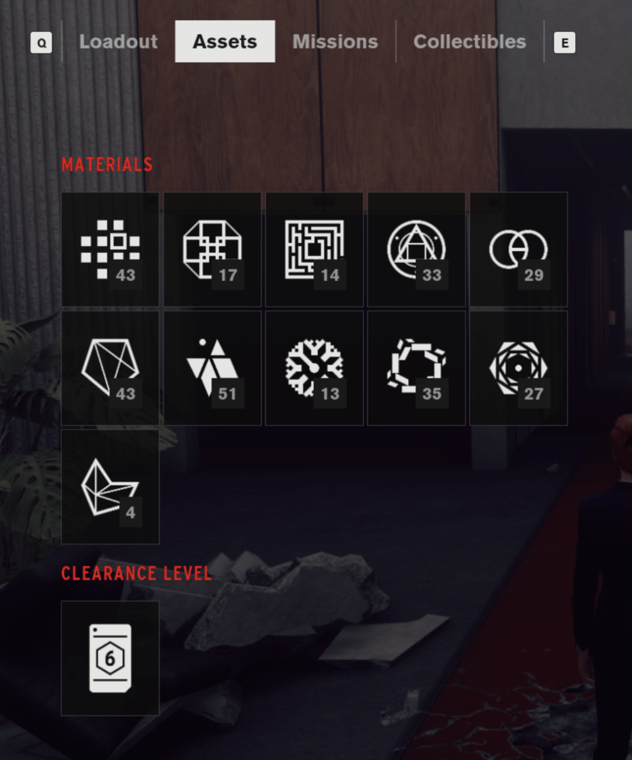
Views
Partition to standalone Views
Unique Identification of each View
View Types for shared behavior
Event Based, no direct access to other Views
Just because two UIs share a common part doesn’t mean they need to be clumped to one View

Slide 7
Views
Need to be able to react to different lifetime events
Register opening/closing events in Created
Register visual change events in Initialize View
Clean up your delegates
Should include both C++ functions and Blueprint delegates
Instantiated (game start)
Created
Opened
Initialize View
Optional (when on top)
Refocus
Closed
Deinitialize View
Destroyed
Removed

Slide 8
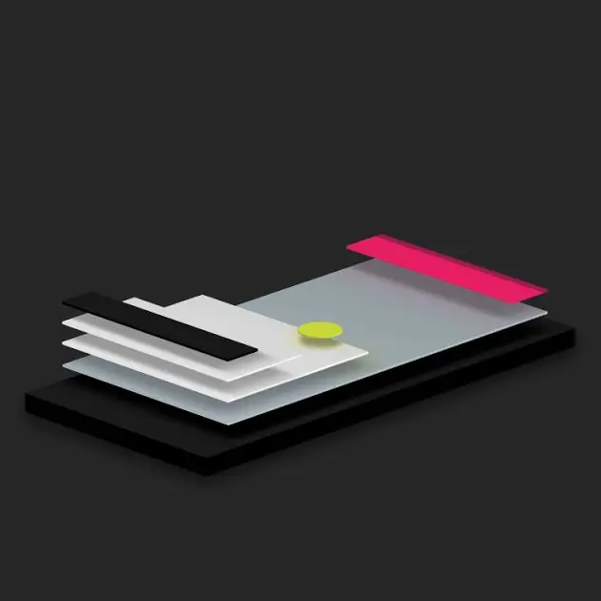
Layers
Grouping of Views
Rendering order
Visibility manipulations
99% predefined
Use of Layer Widget

Slide 9
UI Management
Automates processes
Contains current state of UI
Creates and Destroys Views
Only manager can manipulate Views
Should be “black box” feature, doesn’t need to bother you when coding Views themselves
Can be configurable for different levels
Can be implemented either through Subsystem or HUD actor

Slide 10
Additional Resources
UI Material Use
Basic Optimizations
CommonUI Overview
CommonUI Tutorial

